Slide 1
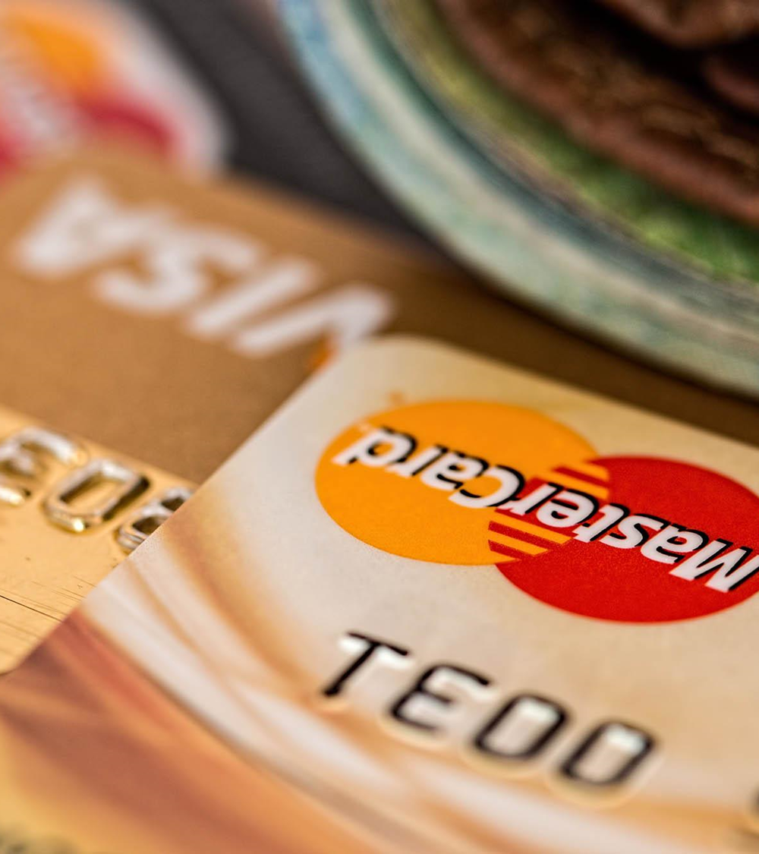


Customer Attrition :- Credit Card Analysis
By
Anuj Sawant
Jalaludeen H
Hema Peta

Slide 2
Problem Statement
Predictive Modelling
Data Mining
DATA SCIENCE CYCLE
Feature Engineering
Data Cleaning
Data Exploration

Slide 3
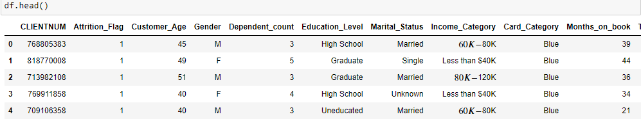
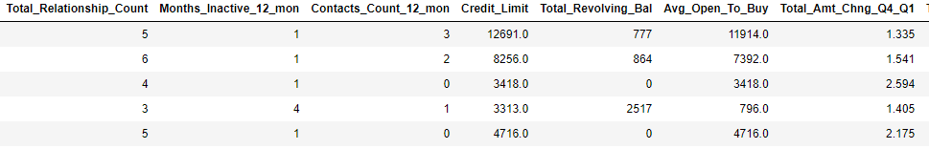
Attribute Information
PROBLEM STATEMENT
CLIENTNUM : Unique identifier for each customer.
Attrition_Flag : Flag indicating whether or not the customer has churned out.
Customer_Age : Age of customer.
Gender : Gender of customer.
Dependent_coun : Number of dependents that customer has.
Education_Level : Education level of customer.
Marital_Status : Marital status of customer.
Income_Category : Income category of customer.
Card_Category : Type of card held by customer.
Months_on_book : How long customer has been on the books.
Total_Relationship_Count : Total number of relationships customer has with the credit card provider.
Months_Inactive_12_mon : Number of months customer has been inactive in the last twelve months.
Contacts_Count_12_mon : Number of contacts customer has had in the last twelve months.
Credit_Limit : Credit limit of customer.
Total_Revolving_Bal :Total revolving balance of customer.
Avg_Open_To_Buy : Average open to buy ratio of customer.
Total_Amt_Chng_Q4_Q1 : Total amount changed from quarter 4 to quarter 1.
Total_Trans_Amt : Total transaction amount.
Total_Trans_Ct : Total transaction count.
Total_Ct_Chng_Q4_Q1 :Total count changed quarter 4 to quarter 1.
Avg_Utilization_Ratio : Average utilization ratio of customer.
The data set contains details of a customers credit card and the target variable is a binary variable reflecting the fact whether the customer who are likely to drop off
df.shape()=(10127,21)

Slide 4
OBJECTIVES
The goal is to develop a machine learning model for Customer Attrition (Credit Card Analysis) using various supervised machine learning classification models and predicting results in the form of best accuracy by comparing supervised algorithms
PROPOSED SYSTEM
The proposed method is to build a Customer Attrition(credit card Analysis) using Machine Learning Technique . We are going to develop a AI based model , we need data to train our model . We can use customers credit card dataset in order to train the model . To use this dataset , we need to understand what the intents that we are going to train are . An intent is the intention of the user interacting with a predictive model or the intention behind each data that the model receives from a particular user .

Slide 5


Slide 6
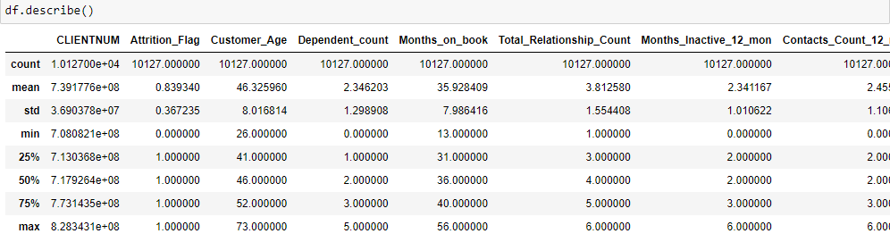
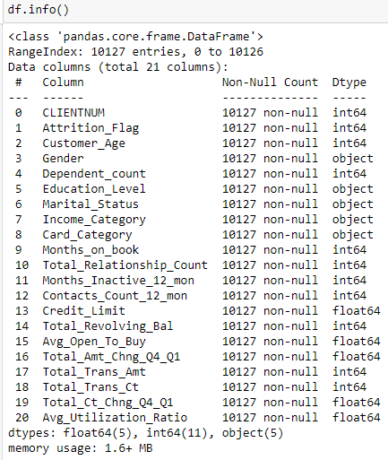
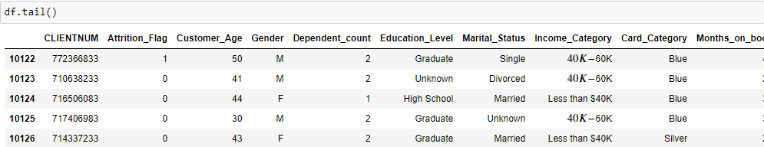
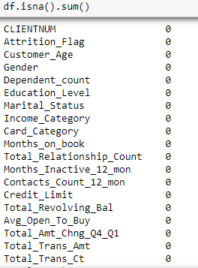

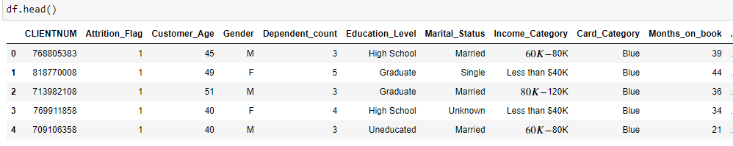

Slide 7


Slide 8
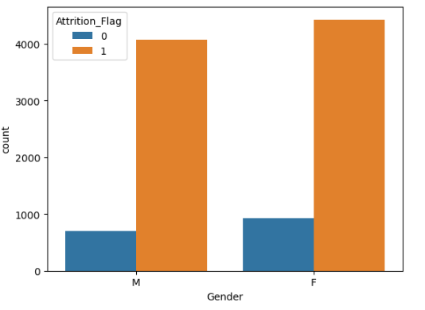
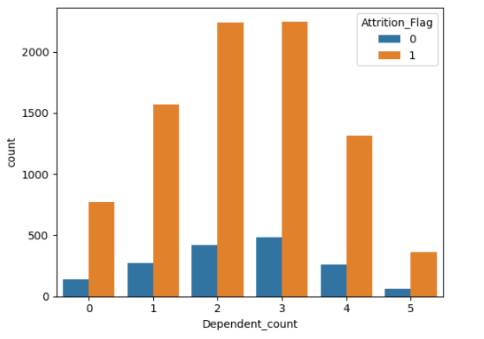
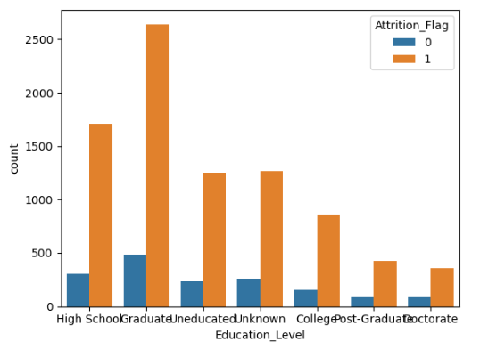
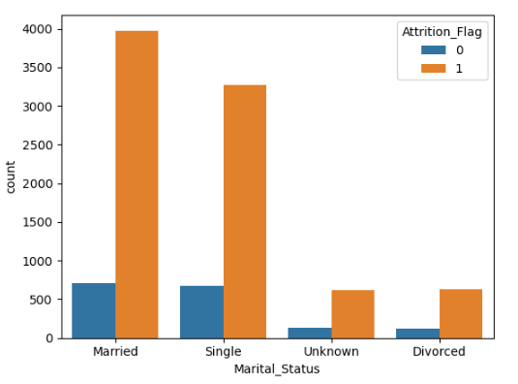
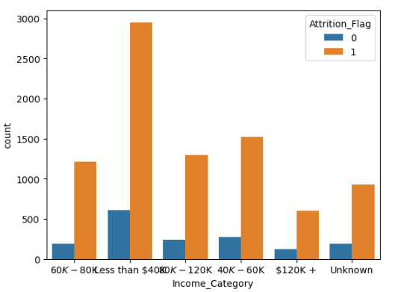
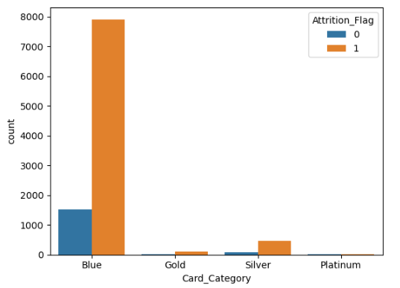
CATEGORICAL VARIABLE

Slide 9
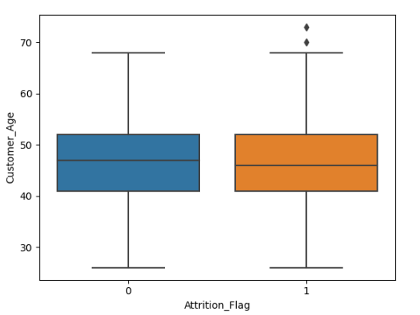
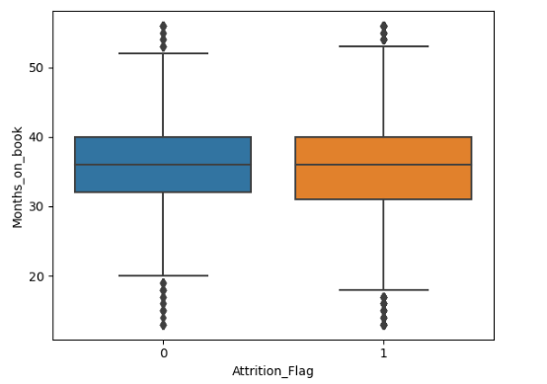
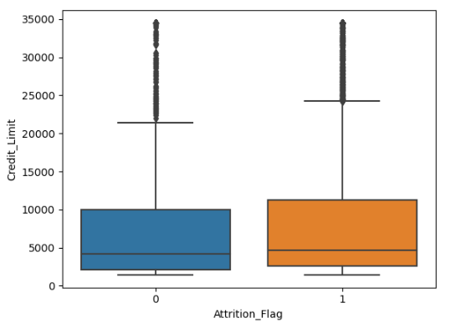

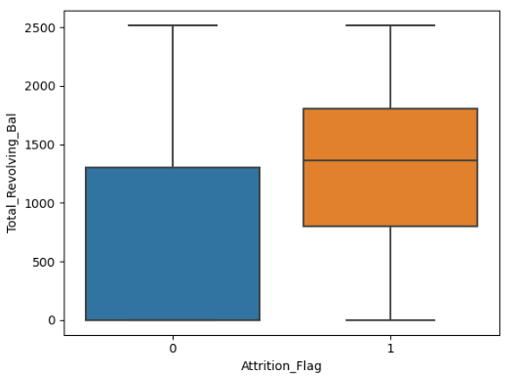
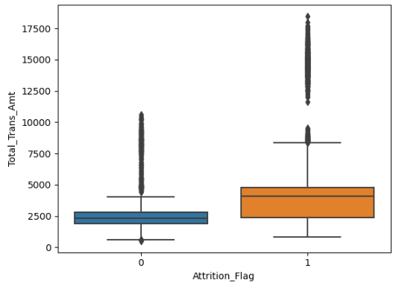
CONTINUOUS VARIABLE

Slide 10
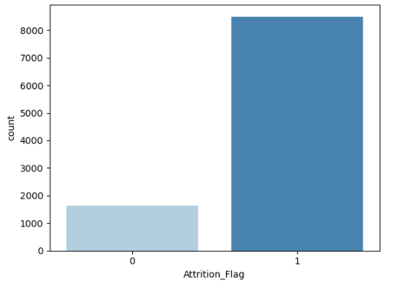
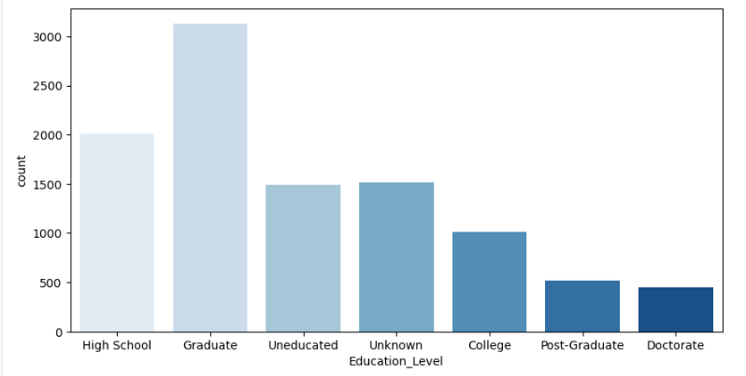
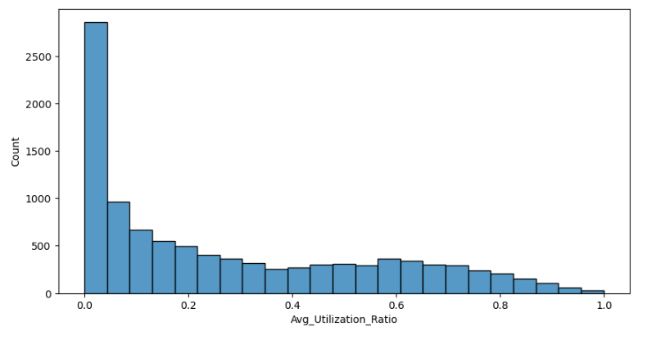
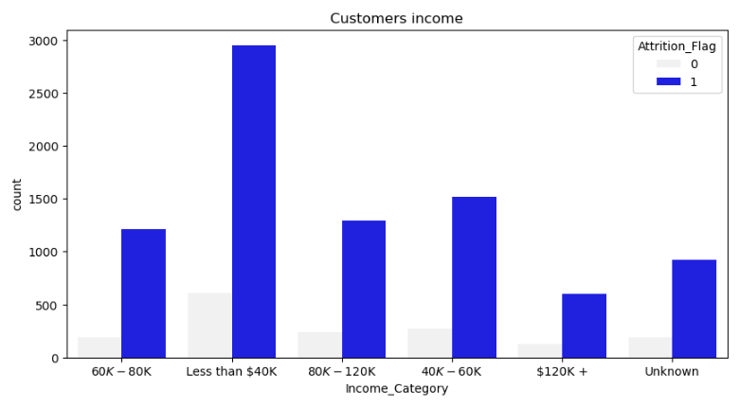
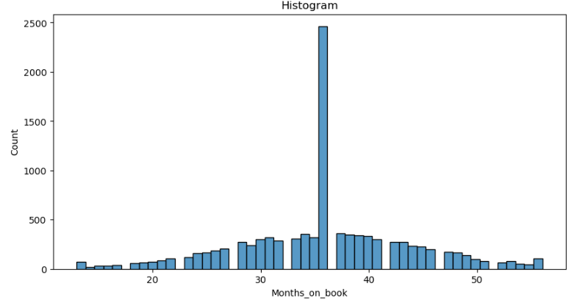
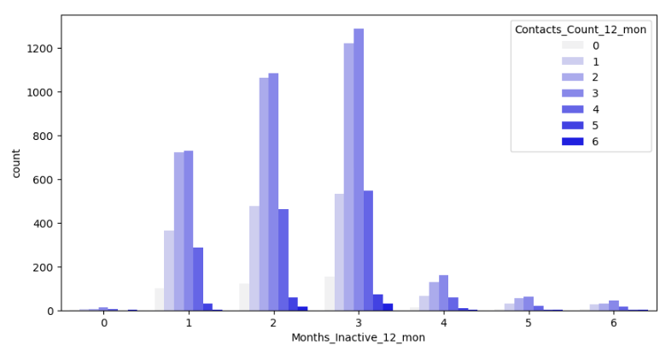
HISTOGRAM

Slide 11
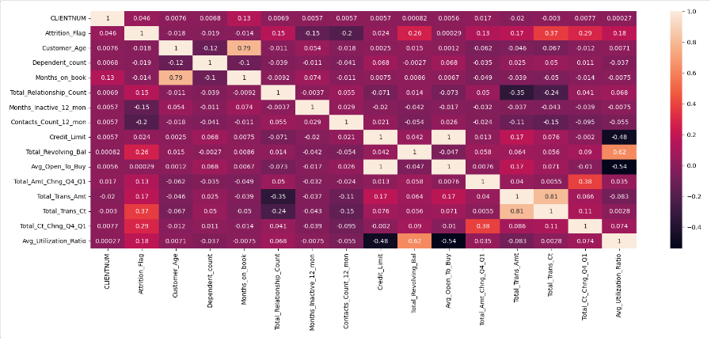
HEAT MAP

Slide 12
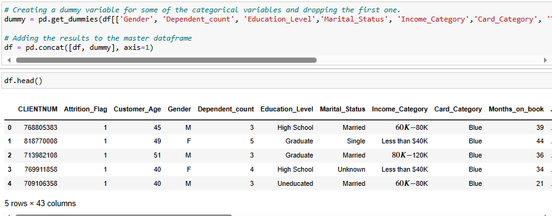
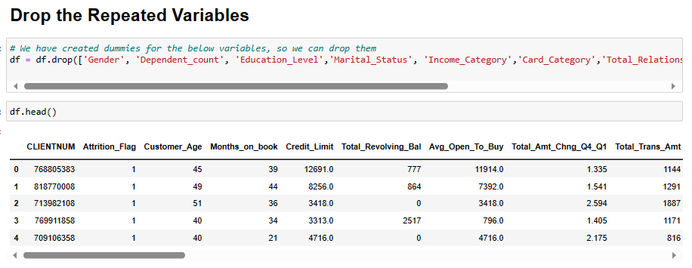
FEATURE ENGINEERING

Slide 13
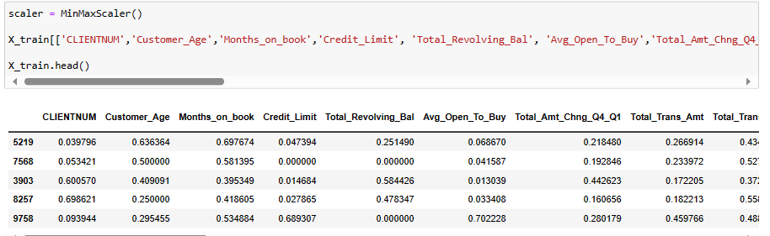
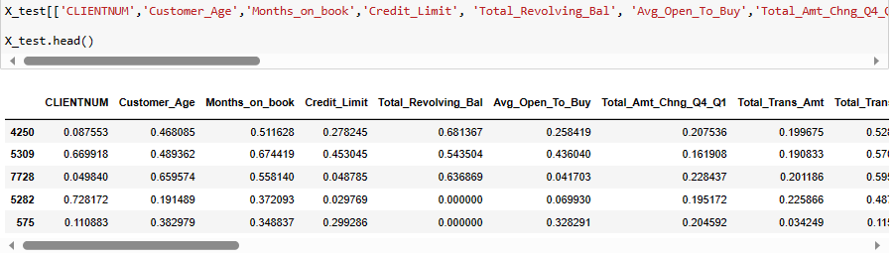
DATA TRANSFORMATION

Slide 14


Slide 15
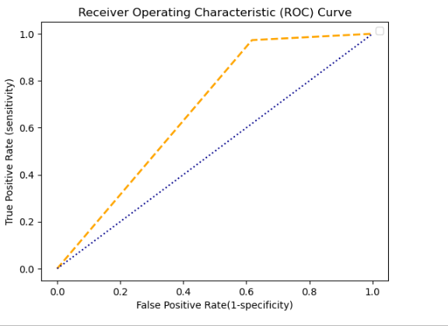
LOGISTIC REGRESSION
Library used : sklearn.linear_model(LogisticRegression)
Accuracy: 87.13
Sensitivity: 74.62
Specificity: 88.34
Precision: 38.24
Recall: 74.82
F-Score: 50.56
AUC: 67.76

Slide 16
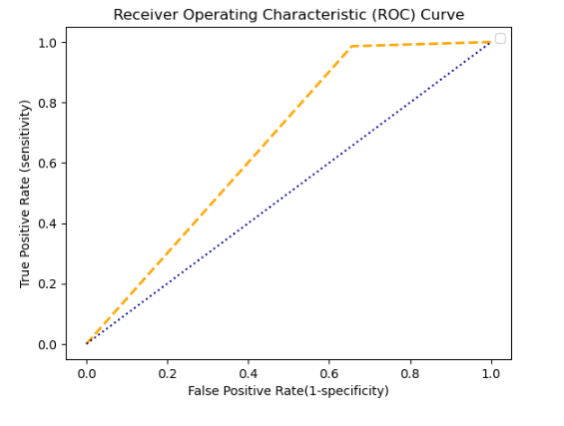
SUPPORT VECTOR MACHINE
Library used:sklearn.svm(SVC)
Accuracy:87.56
Sensitivity:83.72
Specificity:87.85
Precision:34.41
Recall:83.72
F-Score:48.78
AUC:66.51

Slide 17
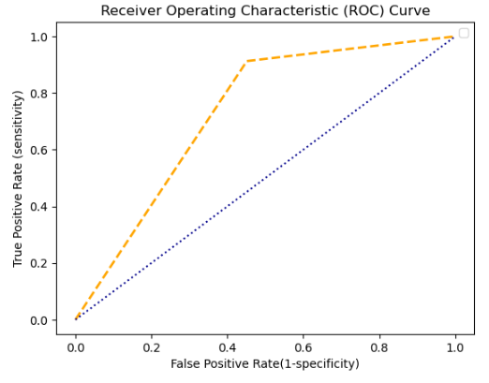
NAIVE BAYES ALGORITHM
Library used:sklearn.naive_bayes( GaussianNB)
Accuracy:84.99
Sensitivity:56.60
Specificity:90.67
Precision:54.87
Recall:56.60
F-Score:55.72
AUC:73.06

Slide 18
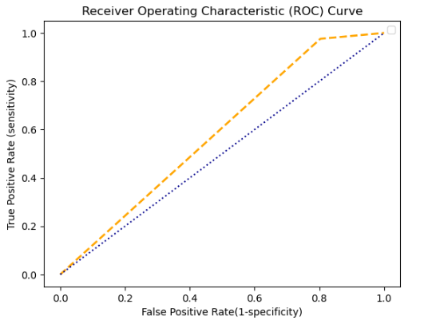
KNN-k nearest neighbour
Library used : sklearn.neighbors (KNeighborsClassifier)
Accuracy:84.17
Sensitivity:62.80
Specificity:85.39
Precision:19.69
Recall:62.80
F-Score:29.98
AUC:58.63

Slide 19
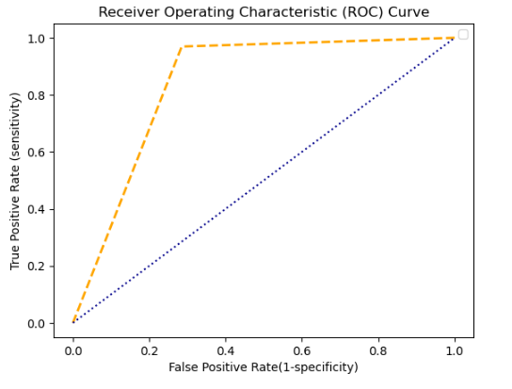
DECISION TREES
Library used : sklearn.tree (DecisionTreeClassifier)
Accuracy:92.56
Sensitivity:82.92
Specificity:94.24
Precision:71.51
Recall:82.91
F-Score:76.79
AUC:84.22

Slide 20
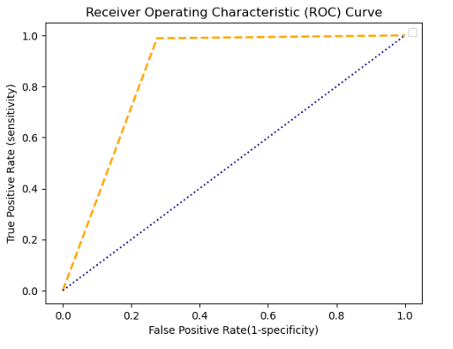
RANDOM FOREST
Library used : sklearn.ensemble (RandomForestClassifier)
Accuracy:94.30
Sensitivity:92.89
Specificity:94.52
Precision:72.46
Recall:92.89
F-Score:81.41
AUC:85.65

Slide 21
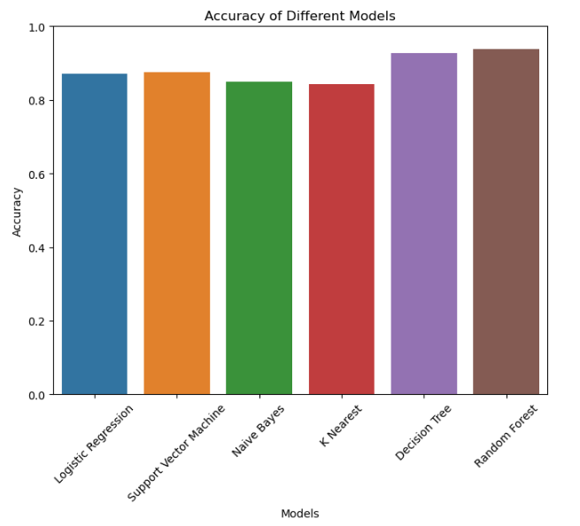
ACCURACY COMPARISON
Random forest has the highest accuracy among all the models which is 94.30%

Slide 22

Anuj Sawant
Anujsawant51@gmail.com
EBEON0323780180
Hema Peta
hemapetabsc007@gmail.comEBEON0322435796
Jalaludeen H hdeen7@gmail.com
EBEON0323780050

